Slide 1
CONTEXT AWARE INDIAN SIGN LANGUAG TRANSLATION
PIP4001 University Project-II
Review-4
Batch Number: CSD-32
Roll Number | Student Name
20211CSD0123 | Aryan SP
20211CSD0060 | Rakesh Kumar Jhar
20211CSD0145 | RishiKanth Reddy K
20211CSD0088 | Yogesh Seervi B
Under the Supervision of,​
​Prof. Ankita Bhaumik​
School of Computer Science and Engineering​
Presidency University​
​
Name of the Program:Computer Science Of Engineering (Data Science) ​
Name of the HoD: Dr. Saira Bhanu​ Atham
Name of the Program Project Coordinator: Dr. Manjula H M​
Name of the School Project Coordinators: Dr. Sampath A K / Mr. Md Ziaur Rahman

Slide 2
Introduction
Sign language, including Indian Sign Language (ISL), is a primary communication method for millions of Deaf and hard-of-hearing individuals globally.
Despite its importance, sign language recognition, translation, and accessibility face significant technological challenges.
Existing sign language translation technologies predominantly focus on American Sign Language (ASL) and other Western sign languages, leaving ISL significantly under-resourced. This research gap creates communication barriers for an estimated 5-7 million ISL users in India, limiting their access to essential services.
This study aims to address this gap by developing context-sensitive translation models specifically for ISL.
The main objective is to improve the accuracy and consistency of ISL translation through advanced disambiguation and natural language processing techniques, recognizing the critical need for linguistic accessibility for under-researched sign languages.

Slide 3
Another major obstacle is the scarcity of large-scale, annotated ISL datasets, which hinders the development and training of effective machine learning models. Regional variations in ISL further complicate this issue.
This paper introduces a novel context-sensitive ISL translation approach that integrates visual sign recognition with higher-level natural language processing to significantly enhance translation accuracy by leveraging contextual factors and semantic reasoning to overcome disambiguation challenges

Slide 4
Literature Review
Multimodal Deep Learning: Combines textual, audio, and visual inputs to enhance the accuracy of Indian Sign Language (ISL) translation by recognizing hand gestures, facial expressions, and body movements.
Unimodal Limitations: Traditional systems relying solely on hand tracking fail to capture the full meaning of ISL, which requires understanding of non-manual cues.
Machine Learning Integration: Utilizes voice synthesis, RNNs or transformers for gesture recognition, and CNNs for feature extraction, improving the translation process.
Real-Time Sign Language Recognition (SLR): Employs deep learning techniques to provide instantaneous translation of sign language into text or voice, overcoming the limitations of human interpreters.
Advanced Neural Networks: Uses LSTM networks for time-series data, RNNs or transformers for sequential gesture modeling, and CNNs for spatial feature extraction.
Optimized Architectures: Implements models like MobileNet and YOLO for real-time performance, making SLR systems accessible on mobile devices.

Slide 5
Voice Synthesis Technology: Converts sign language into natural-sounding speech through a multi-step process involving gesture recognition, text production, and advanced TTS models.
Natural Language Processing (NLP): Enhances translation accuracy by addressing structural differences between spoken and sign languages, ensuring grammatical correctness and contextual understanding.
Interactive Learning Tools: Utilizes AI, AR, and VR technologies to create engaging and personalized sign language learning experiences, providing real-time feedback and gamified learning.
Future Developments: Ongoing research in multimodal learning, self-supervised learning, and AI-driven technologies aims to improve the accuracy, accessibility, and inclusiveness of sign language translation systems.

Slide 6
Proposed Method
Problem Definition and Research Scope: The proposed methodology addresses the challenges faced by the deaf and hard-of-hearing community in recognizing and translating Indian Sign Language (ISL) due to its complexity, regional variations, and limitations of existing systems. The goal is to develop a real-time, multimodal deep learning-based ISL identification system that enhances sign-to-text and sign-to-speech conversion while ensuring ethical AI deployment.
Dataset Preparation and Augmentation: A diverse and high-quality dataset is essential for training ISL recognition models. The methodology involves collaborating with deaf communities and experts to gather a comprehensive dataset, ensuring accurate annotation of gestures. Data augmentation techniques will be employed to enhance generalization and prevent overfitting, including spatial and temporal adjustments, as well as synthetic gesture generation using Generative Adversarial Networks (GANs).
Model Selection and Training: The methodology emphasizes selecting appropriate deep learning models, such as CNNs for spatial data extraction and LSTMs or Transformers for temporal sequence processing. Transfer learning will be utilized to improve model performance and reduce training time, while hyperparameter optimization will enhance model accuracy and efficiency.

Slide 7
Gesture Classification and Recognition: The system will employ CNNs for static gesture classification and LSTMs or RNNs for dynamic gesture recognition. A hybrid approach combining CNNs, LSTMs, and Transformers will be used to effectively handle both static and dynamic signs, ensuring accurate recognition of ISL gestures.
Multimodal Learning for Improved Accuracy: The methodology incorporates multimodal learning by combining visual, depth, and sensor-based data to enhance gesture recognition accuracy. This approach allows the system to better understand the context of gestures and improve performance in various environmental conditions.
User Interface and System Deployment: A user-friendly interface is crucial for accessibility. The system will feature a clear and intuitive design, with customization options for users. It will be deployed across multiple platforms, including desktop, web, and mobile applications, to ensure widespread accessibility.
API Integration: The ISL recognition system will integrate with third-party accessibility tools and services, such as text-to-speech and speech-to-text APIs, to facilitate communication between hearing and non-hearing individuals. This integration will enhance the system's capabilities and improve accessibility for users with different impairments.
Scalability and Performance: The proposed methodology emphasizes the need for a scalable infrastructure that ensures high speed, low latency, and reliability for real-world deployment.

Slide 8
Objectives
inclusivityEnhancing Communication Accessibility:Develop an automated ISL recognition system to bridge the communication gap between deaf individuals and the hearing population, improving accessibility in public services, healthcare, education, and workplaces.
Developing an Accurate Gesture Recognition System:Create a reliable gesture detection system that accurately captures complex ISL gestures, facial expressions, and movements using deep learning techniques, pose estimation models, and data augmentation methods.
Integrating Deep Learning for Better Gesture Classification:Utilize deep learning models like CNNs, RNNs, and Transformers to enhance gesture classification accuracy and efficiency, incorporating multimodal data sources for comprehensive movement descriptions.
Creating a User-Friendly and Accessible Interface:Design an intuitive and accessible user interface for the ISL recognition system, featuring gesture-based navigation, real-time feedback, and customization options to cater to diverse user needs.
Addressing Ethical and Privacy Concerns in AI-Based ISL Systems:Ensure user data privacy and security in AI-driven ISL systems by implementing robust encryption, user control over data, and addressing biases in AI models to promote .

Slide 9
Encouraging Inclusive Education and Awareness:Integrate ISL recognition systems into educational institutions to support hearing-impaired students, fostering an inclusive learning environment and promoting awareness among peers.
Facilitating Healthcare Accessibility:
Transform healthcare communication for hearing-impaired patients by enabling real-time translation of ISL gestures, improving interactions with medical staff, and ensuring clarity in medical consultations.
Promoting Digital Inclusion and Accessibility:
Enhance access to online information and services for individuals with hearing impairments by integrating ISL translation tools into digital platforms, closing the digital divide.
Enhancing Legal and Judicial Access:
Improve accessibility to legal and judicial processes for deaf individuals by facilitating communication through ISL recognition devices, ensuring adherence to disability rights standards and the right to a fair trial.
Fostering Social Inclusion:
Overall, the objectives aim to create a more inclusive society where deaf and hard-of-hearing individuals can communicate freely, participate fully in various aspects of life, and have equal access to opportunities and services.

Slide 10
Expected Outcomes
Enhanced Communication Accessibility: Real-time translation of ISL into text and speech, promoting inclusivity and reducing reliance on interpreters.
Real-Time Gesture Recognition: Effective recognition of static and dynamic gestures using CNNs and LSTM/GRU networks for smooth gesture-to-text conversion.
Multilingual Output Support: Capability to translate ISL gestures into multiple Indian languages, increasing inclusivity across diverse linguistic backgrounds.
User -Friendly Interface: Intuitive UI with visual gesture previews, real-time feedback, and easy navigation for users with minimal technical knowledge.
Educational and Social Impact: Enhances learning for deaf students and empowers hearing-impaired individuals to engage confidently in social interactions.
Prototype Deployment and Usability Testing: High user satisfaction rates from pilot deployments, validating the system's effectiveness in real-world applications.
Foundation for Future Research and Development: Establishes groundwork for continuous ISL recognition and emotion analysis, allowing for future enhancements.
Support for Continuous Sign Recognition: Initiates recognition of continuous sign sequences for natural conversation flow in sign language communication.

Slide 11
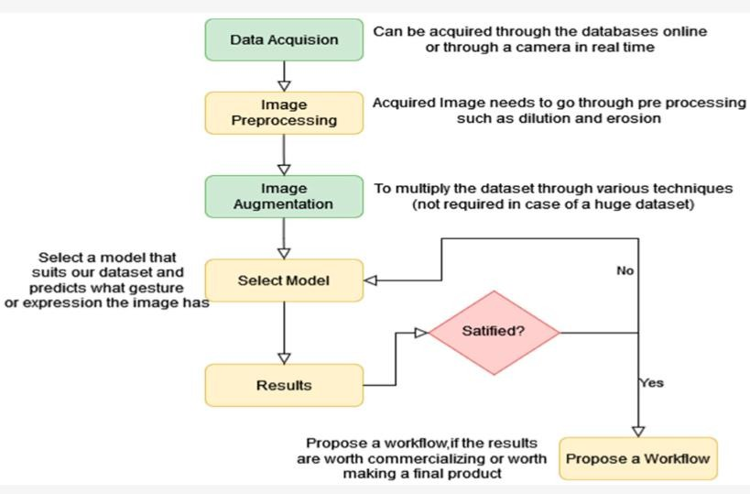
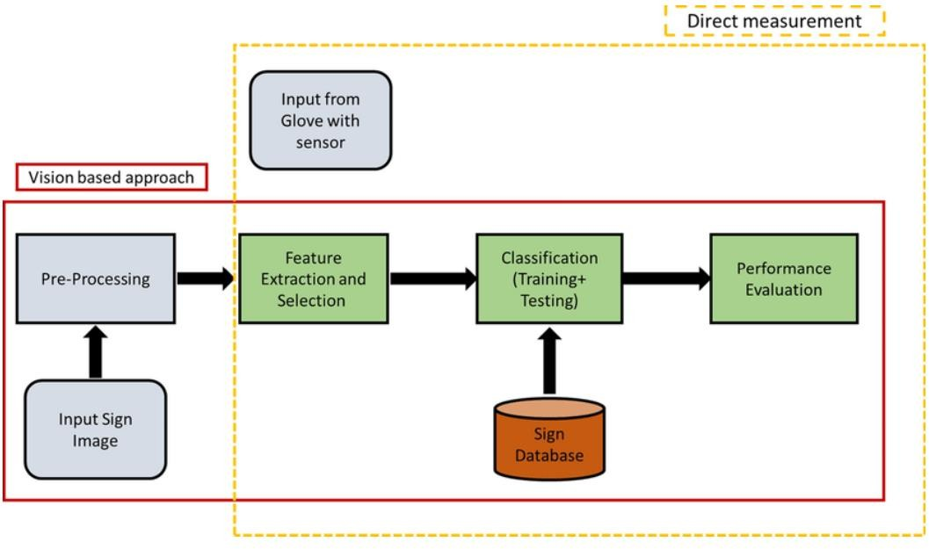
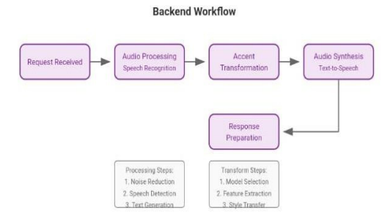
Architecture

Slide 12
Timeline of Project
Review 1
Review 2
Review 3
. The project was planned to be executed
Project planning and team assignment
Requirements gathering and research
Design UI/UX for the website
Develop user interface for uploading file module
particular set of tasks, including research, development, testing, and
deployment

Slide 13
Conclusion
The Indian Sign Language (ISL) translation system represents a significant advancement in bridging the communication gap between India's hearing and Deaf communities, addressing the needs of over 63 million individuals with hearing impairments. This research has developed a deep learning-based framework for ISL detection and translation, focusing on scalable and socially beneficial solutions that promote equitable access to information. By exploring innovative methodologies such as transformer models for context-aware translation, LSTM and GRU architectures for temporal modeling, and CNNs for gesture recognition, the system enhances accuracy and usability. A key achievement is the creation of a diverse ISL dataset that captures geographical and linguistic variations, improving model performance and addressing existing dataset limitations. The system's real-time capabilities enable practical applications in various settings, while a user-centric design ensures accessibility through a mobile and web-based interface with features like speech synthesis and multilingual support. Furthermore, API integration with third-party platforms extends its reach, establishing a solid foundation for future AI-powered ISL translation systems. Ongoing collaboration with the Deaf community, educators, and policymakers is essential for continued development, bringing the vision of an inclusive, barrier-free communication system for the Deaf in India closer to reality.

Slide 14
Github Link
https://github.com/aaryangowda/CONTEXT-AWARE-INDIAN-SIGN-LANGUAGE-TRANSLATION-.git

Slide 15
References
Poornima B.V., Srinath S. (2023). A Comprehensive Review on Indian Sign Language Recognition System using Vision based Approaches. International Journal of Computer Applications.
Samar Sinha (2023). Indian Sign Language: A Linguistic Analysis of Its Grammar Gallaudet University Press.
Kartik Shenoy, Tejas Dastane, Varun Rao, Devendra Vyavaharkar (2021). Real-time Indian Sign Language (ISL) Recognition. arXiv preprint.
Velmathi G., Kaushal Goyal (2023). Indian Sign Language Recognition Using Mediapipe Holistic. arXiv preprint
Mallikharjuna Rao K., Harleen Kaur, Sanjam Kaur Bedi, M A Lekhana (2023). Image- based Indian Sign Language Recognition: A Practical Review using Deep Neural Networks. arXiv preprint.

Slide 16
Prem Selvaraj, Gokul NC, Pratyush Kumar, Mitesh Khapra (2021). OpenHands: Making Sign Language Recognition Accessible with Pose-based Pretrained Models across Languages. arXiv preprint.
Abhinav Joshi, Susmit Agrawal, Ashutosh Modi (2023). ISLTranslate: Dataset for Translating Indian Sign Language. arXiv preprint.
Seema P. Singla (2022). Translation of Indian Sign Language to Text-A Comprehensive Review. International Journal of Innovative Science and Applied Engineering.
Annelies Kusters (2023). Deaf scholar promoted to full professor in deaf studies in UK first. The Guardian.
10. Yogeshwar Ishwar Rokade, Prashant M. Jadav. Indian Sign Language Recognition
System. International Journal of Engineering and Technology, July 2017.

Slide 17
Thank You

